Slide 1
Self-driving Vehicles
About
Jin-Yong Seo
Seo-young Choi

Slide 2
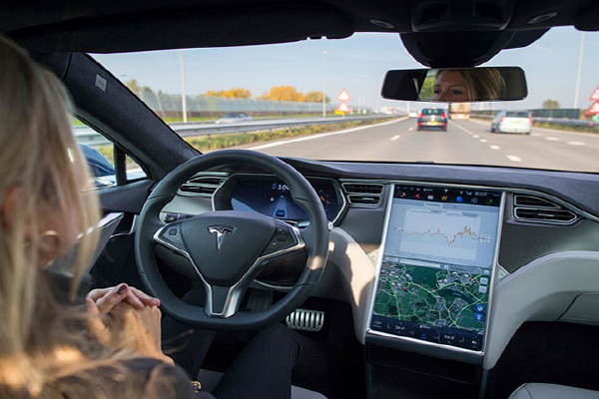

What is Self-driving Vehicle?
It is a vehicle that is capable of sensing its environment
and moving safely with little or no human input
If I drive, an ACCIDENT will happen :(
Leave it to Machine

Slide 3

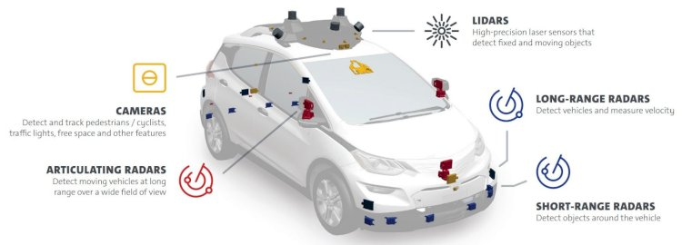
Tech.1 – IoT Sensors
To replace people’s senses

Slide 4

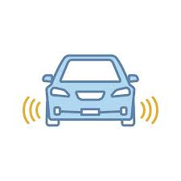
Tech.2 – IoT Connectivity
By sharing information about road (such as actual path, traffic, obstacles, etc) helps them monitor their surroundings better and make informed decisions

Slide 5
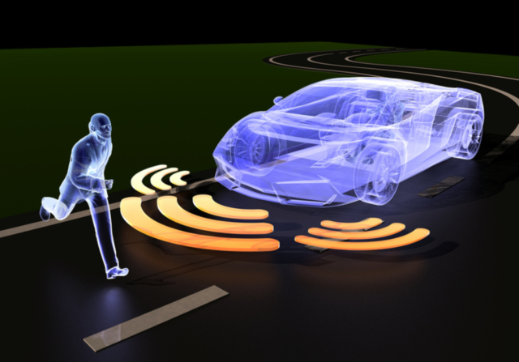
Tech.3 - Software Algorithms
the main function of the control algorithms and software
the most complex part of the self-driving car
determine the best course of action

Slide 6
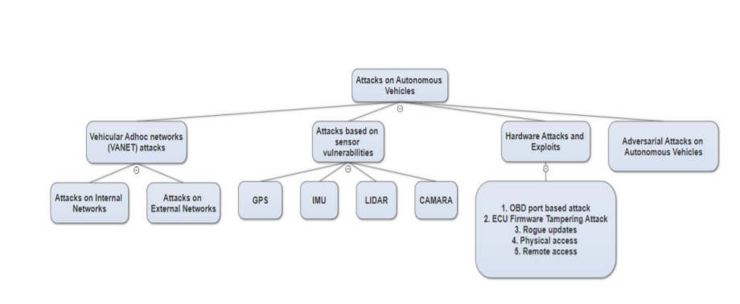

Attacks
User register
Internet Ports
Downloads
Updates

Slide 7
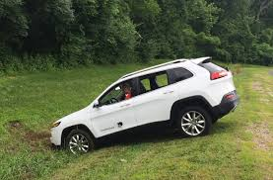
The Hacked Car!!
Car was hacked just by a little bit of automated system
Nonononoooooo
Computers more in charge?
EASIER
Jeep Cherokee

Slide 8

Save our cars!! – Exists…
Battlefield Security
- Autosar CSM (Cryptographic Security Manager),
SecOC(Secure Onboard Communication)
Internal Network Security
- CycurGate
External Network Security
- V2X Message Certification, Encoding
Security Management & Security Diagnosis
-Security Monitoring

Slide 9
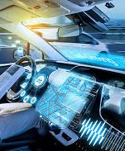




Save our cars!! – Maybe…
During user registration

Slide 10

Save our cars!! – Maybe…
During user registration

Slide 11
Save our cars!! – Maybe…
During user registration

Slide 12

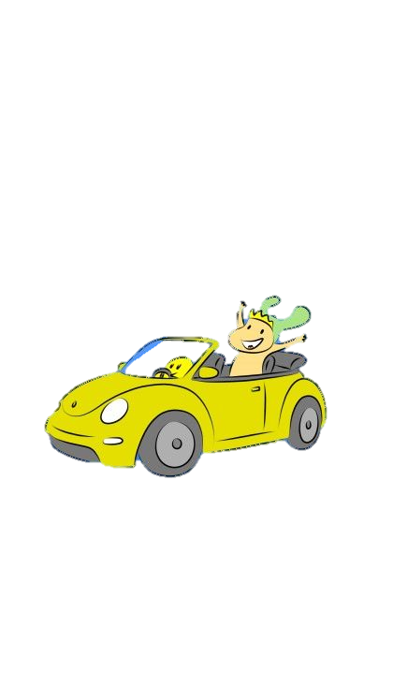



Are we going to use Self-driving Vehicle?
YES!!

Slide 13
Sources
https://www.google.co.kr/imghp?hl=ko
http://www.msdkr.com/news/articleView.html?idxno=10453
https://www.iotforall.com/iot-and-autonomous-vehicles/
https://www.wired.com/2017/04/ubers-former-top-hacker-securing-autonomous-cars-really-hard-problem/
https://ettrends.etri.re.kr/ettrends/169/0905169008/

